Slide 1
Adaptation Test Practice

Slide 2
Barn Swallows
The outermost tail feather of the male barn swallow is longer than that of the female barn swallow. The long tail feather helps the male attract females, but it also requires the males to use extra energy to fly.
1. The long tail feather trait is maintained in the barn swallow population because, compared to males with a shorter tail feather males with a longer tail feather are more likely to:
A) Build a large nest.
B) Migrate each winter.
C) Produce offspring
D) Escape from predators.

Slide 3
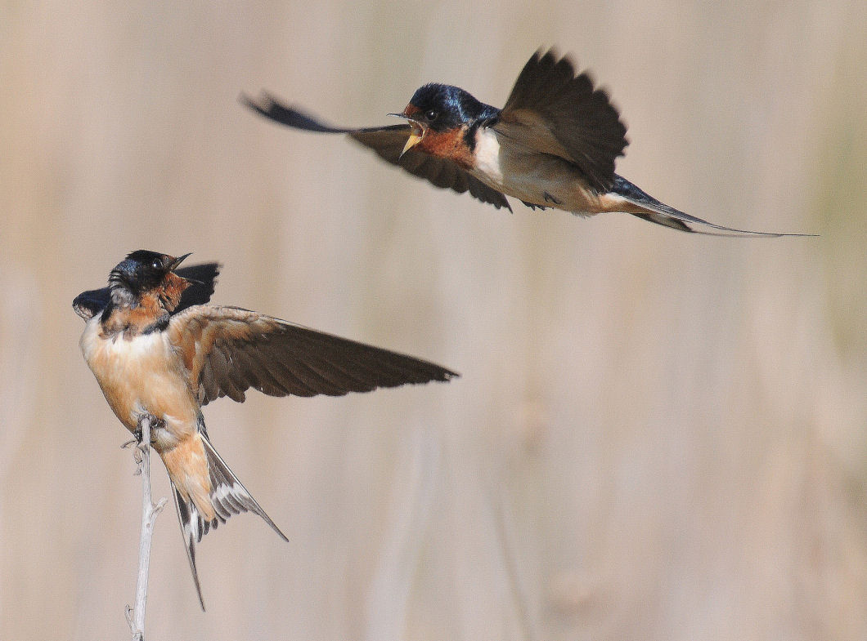

Slide 4
Which of the following adaptations would be MOST useful for desert plants?
A) Deep roots
B) Broad leaves
C) Waxy Skin
D) Spines

Slide 6
Dutch elm disease is a fungal infection of elm trees that usually results in death. The disease has killed millions of North American elm trees that were not resistant to the fungus. Scientists have bred resistant elms by crossing North American species with Asian species that show resistance.
Which of the following best describes how natural selection would promote resistant elm populations once the resistance genes from the Asian species were successfully introduced?
A) After encountering elms with resistance genes, fungi would avoid elms and begin to attach other tree species.
B) By reproducing with each other, elm trees with resistance genes would create super-resistant elms with twice the number of resistance genes.
C) Resistance would spread to all of the mature elms in a population from a few trees that acquired the resistance genes.
D) Elm trees with resistance would survive and would pass on resistance to offspring, while trees without resistance would be killed by the fungus.

