Slide 1
Adaptations

Slide 2
Get out a piece of paper and write down:
Three sentences explaining what you know about adaptations.

Slide 3
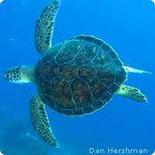
Adaptations
Adaptations = characteristics that improves an individuals ability to survive and reproduce in a particular environment.
`

Slide 4
Obtaining Food
Ex: The chameleon has a long, sticky, and fast tongue.
This is a great adaptation or catching insects.

Slide 5
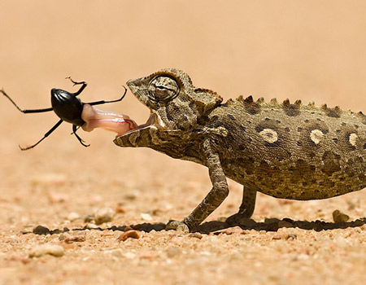

Slide 6
Obtaining Food
Ex: The woodpecker has a strong beak to drill holes into wood.
Then he can get the bugs that are inside the tree.

Slide 7
Ai Ai

Slide 8
Obtaining Food
Why would an adaption for obtaining food be important?
Think of the food you eat, what adaptations do we have that helps us obtain food?

Slide 9
Predator-Prey
Some adaptations serve as defense against predators.
Ex: The porcupine has quills that would hurt the predator

Slide 10
Predator-Prey
The puffer fish can expand its body, which causes sharp prongs to expand outward.

Slide 11
Predator-Prey
Others have bright marking which are common in poisonous animals.
Ex:The coral snake for example

Slide 12
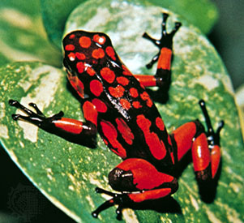
Predator-Prey
Or poisonous frogs

Slide 13
Predator-Prey
Another example is camouflage
Ex: The alligator can be underwater except for its eyes and nostrils

Slide 14
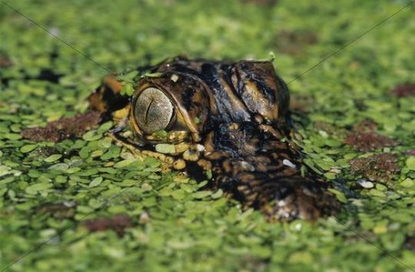

Slide 15
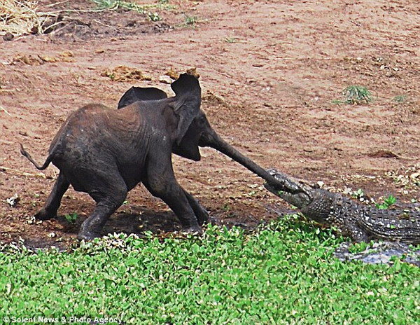

Slide 16
Predator-Prey
There are many insects with camouflage to protect themselves

Slide 18
Predator-Prey
Why is it important to have a predator in a population?
What do you think would happen if there were no predators?
Do you believe that prey having predators is a good or bad thing?

Slide 19
Interaction
Two species can adapt to interact with one another
For example, the clown fish and anemone

Slide 20
Interaction
And the honeycreeper and the lobelia
The honey creepers beak fits perfectly in the tube to get nectar

Slide 21
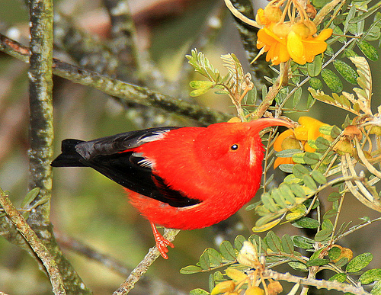
And the honeycreeper gets the pollen on his head and pollinates other lobelias

Slide 22
Drawing Prompt

Slide 24
Take some time to analyze and think about the environment created inside of a refrigerator.
Temperature
Darkness
Obtaining food
Predator/Prey

Slide 25
On a blank sheet of paper, make a drawing of an organism and what adaptations would be needed to survive, thrive and reproduce in the environment of a refrigerator.

Slide 26
Natural Selection
Charles Darwin was the first to see Natural Selection on the Galapagos Islands

Slide 27
Natural Selection
Natural Selection = the process by which individuals that are better adapted to their environment, survive and reproduce.
There are 4 steps to Natural Selection
Overproduction
Genetic Variation
Struggle to Survive
Successful Reproduction

Slide 29
Overproduction
More offspring born than will become adult.

Slide 30
Genetic Variation
Individuals are different. The stronger may survive and weaker will not.

Slide 31
Struggle to Survive
May not be enough food.
May be killed by predator.
May not find a mate.

Slide 32
Successful Reproduction
Key to Natural Selection.
Only those with adaptations to survive will reproduce.

Slide 33
Natural Selection
For example, the Sea Turtle
The turtle struggles onto shore in order to lay eggs

Slide 34
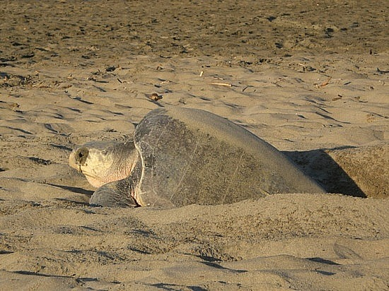
They then dig a hole, it can take them an entire day just to get on the beach and dig a hole

Slide 35
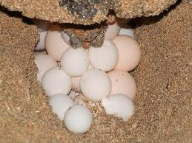
They then lay their eggs, which can again take an entire day or night

Slide 36
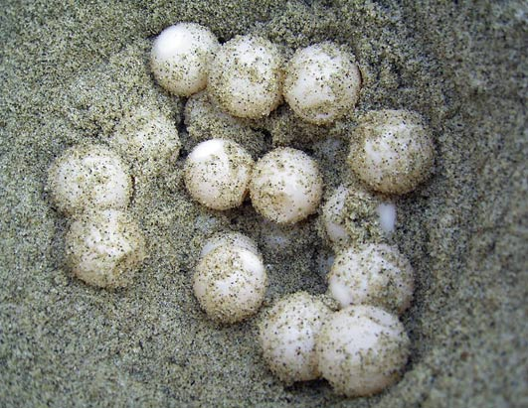
They leave those eggs and go back to the ocean, hoping their eggs make it to the point of hatching

Slide 37
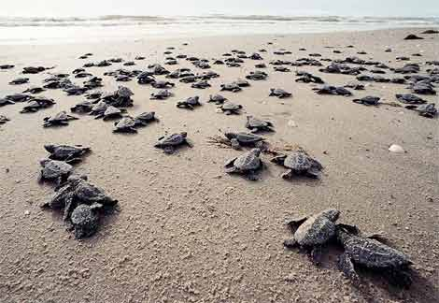
Once the eggs that are left hatch, the babies have to make it to the ocean

Slide 38
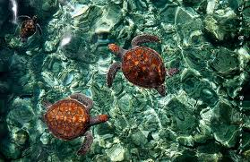
Then, they have to find food and camouflage to survive so that they can one day reproduce

Slide 39
Genetic Bottleneck
When a population is reduced to a few members, and the number of characteristics in the population decreases.

Slide 40
Genetic Bottleneck

Slide 41
Insecticide Resistance
When certain insects in a population are resistant to insecticide. This means the bug spray does not kill them.

