Slide 1
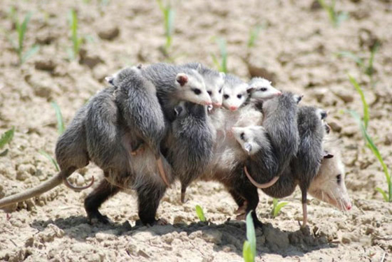
Animal Reproduction Chapter 3 section 1

Slide 2
Animal Reproduction
For a species to survive, some members of the species must reproduce.

Slide 3
Animal Reproduction
But…how does an animal find a mate if they are “glued” to one spot?

Slide 4
Animal Reproduction
Over time, animals develop methods of reproduction that suit their environment.

Slide 5
2 Types of Animal Reproduction
Asexual
Sexual

Slide 6
Definitions
Asexual
Sexual
Reproduction that does not involve the union of sex cells in which a single parent produce identical offspring
Reproduction in which sex cells from two parents unite to produce offspring that share traits from both parents

Slide 7
Facts
Asexual
Sexual
Single parent
Offspring identical to parent
Can produce many offspring in short amount of time
Two parents
Offspring are a variation of parents
Fewer offspring in a longer amount of time

Slide 8
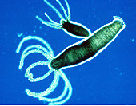
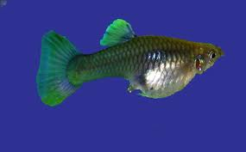
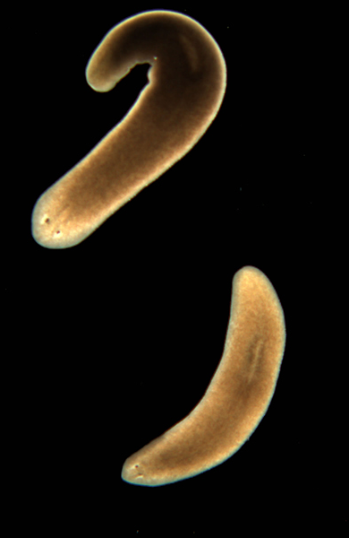
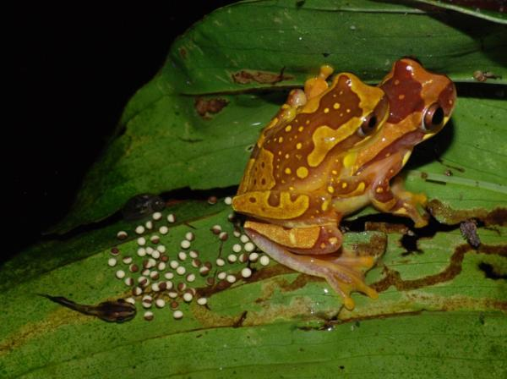
Patterns
Asexual
Sexual
Budding
Fragmentation
Regeneration
Fertilization
Internal
External

Slide 9
Budding

Slide 10
Budding

Slide 11
Budding
Hydra
Cactus

Slide 12
Budding
Hydra
Yeast Budding

Slide 13
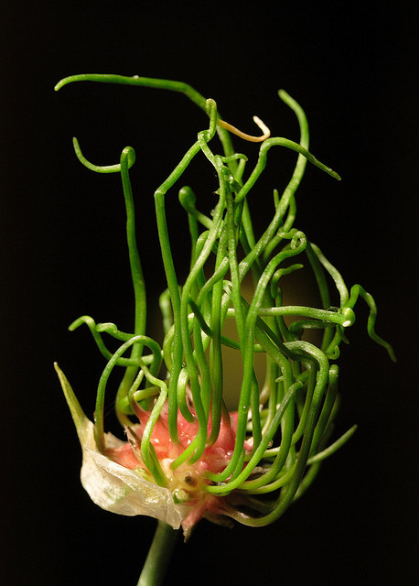
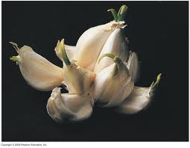
Budding
Potato
Garlic

Slide 14
Fragmentation

Slide 15
Fragmentation

Slide 16
Fragmentation

Slide 17
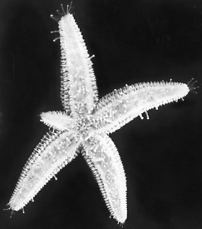
Fragmentation

Slide 18
Fragmentation

Slide 19
Fragmentation

Slide 20
Regeneration

Slide 21
Regeneration

Slide 22
Binary Fission

Slide 23
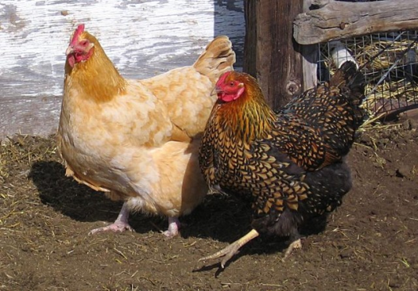
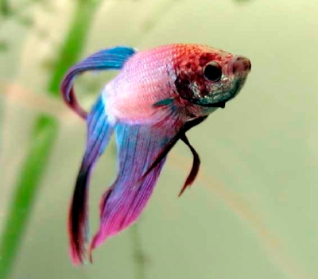
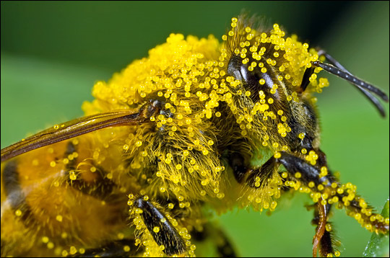
Sexual Reproduction
Happens 2 ways
Internally (inside)
The egg is fertilized by sperm inside the female
Mammals, birds, reptiles, insects, spiders
Externally (outside)
The egg is fertilized by sperm outside the female
The female lays the eggs and then the male fertilizes them.
Fish and some amphibians
Plants and fungi (pollen and spores)

Slide 24
Fertilization

Slide 25
Fertilization

Slide 26
Fertilization

Slide 27
External Fertilization

Slide 28
External Fertilization

Slide 29
External Fertilization

Slide 30
External Fertilization

Slide 31
External Fertilization

Slide 32
External Fertilization

Slide 33
Internal Fertilization

Slide 34
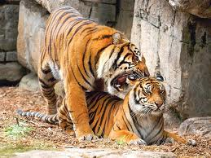
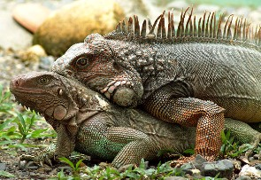
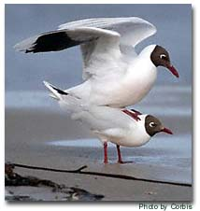
Internal Fertilization

Slide 35
Which is Better? It depends!
Asexual Reproduction
advantages
does not require special cells or a lot of energy
can produce offspring quickly
in a stable environment creates large, thriving population
disadvantages
limited ability to adapt
face massive die-off if environment changes
No parenting
Sexual Reproduction
advantages
lots of variation within a species
able to live in a variety of environmental settings
able to adapt to changes in the environment
Usually involves parenting
disadvantages
needs time & energy
produce small populations

