Slide 1
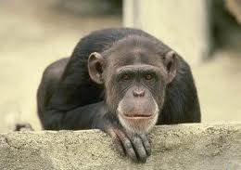
Animal Behavior
Chapter 3 section 3

Slide 2
Animal Behaviors
Refer to the actions and mannerisms made by organisms in conjunction with their environment. It is the response of the organism to certain stimuli.
(it is how an animal acts)

Slide 3
Animal Behavior
Just Think About It
Why do you think animals act the way they do?
How does a newborn know how to breathe?
Who teaches a spider how to make a web?
Where did birds learn how to build a nest?

Slide 4
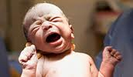
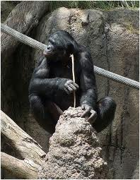
2 Main Behaviors
Innate Behaviors
Instincts
Behaviors inherited through genes
(born with them)
Learned Behaviors
Behaviors learned through experience or observation

Slide 5
Innate Behaviors
There are several innate behaviors that are shared by most animals in one way or another.
7 examples follow:

Slide 6
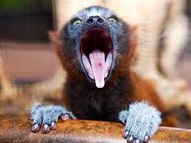
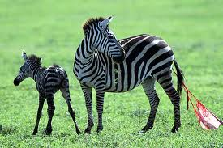
Breathing
Talking (or making sounds)
Walking

Slide 7
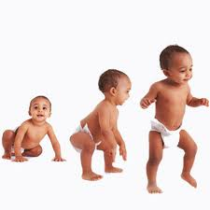
Some innate behaviors are from the moment of birth.
Some show up a few months later

Slide 8
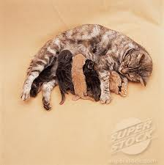
Innate Behaviors
Nursing (or the ability to suckle is an innate behavior)

Slide 9
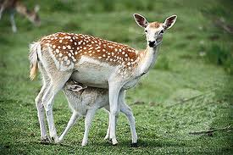

Slide 10
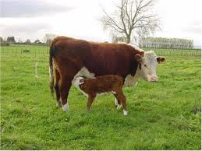
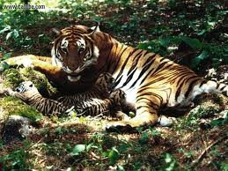

Slide 11
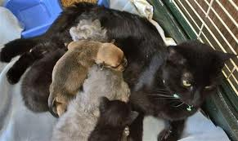
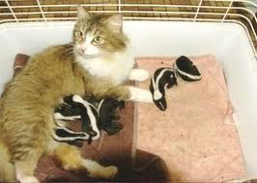
So innate is this behavior that it can even cross species depending on the parental instincts of the mother.

Slide 12
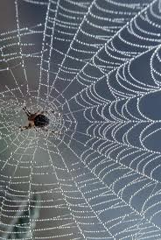
Innate Behaviors
It is an innate behavior for spiders to build their webs

Slide 13
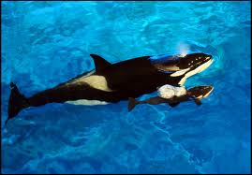
Innate Behaviors
It is an innate behavior for whales to swim immediately after birth

Slide 14
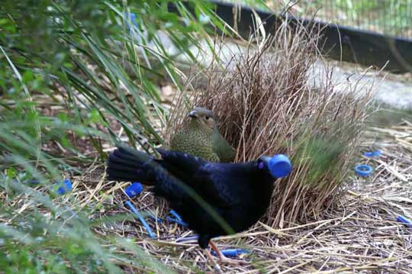
Innate Behaviors
It is an innate behavior for male bower birds to use colorful items when building a nest to attract a mate.

Slide 15
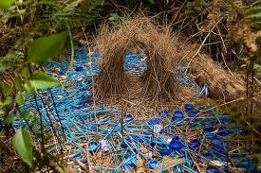

Slide 16
Learned Behaviors
Chimpanzee parents teach their young how to use a stick to dig for termites or other bugs.

Slide 17
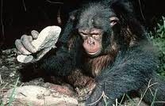
Learned Behaviors
Or how to use tools to get food.

Slide 18
Learned Behaviors
While the ability to speak is innate. Learning to speak a language is learned.

Slide 19
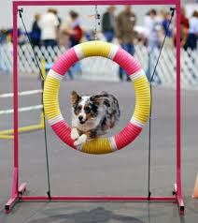
Learned Behaviors
Walking is innate, but dancing or doing tricks is learned.

Slide 20
Innate and Learned Behaviors branch into two other types of behaviors:
Survival behaviors
Seasonal Behaviors
Finding food
Territorial behavior
Defensive behavior
Courtship
Parenting
Migration
Hibernation
Estivation

Slide 21
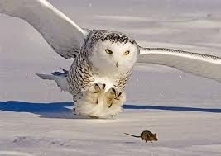

Slide 22
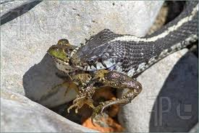

Slide 23
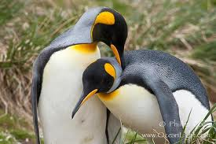

Slide 24
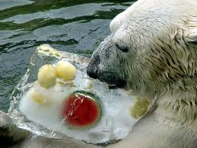

Slide 25
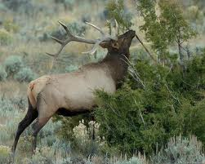

Slide 26
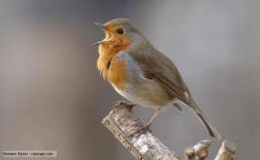

Slide 27
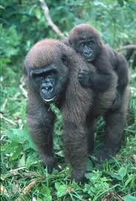

Slide 28
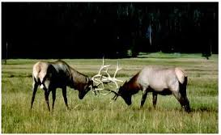

Slide 29
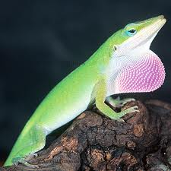

Slide 30
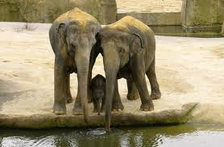
Picture 22

Slide 31
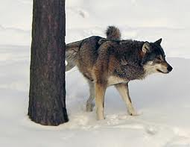
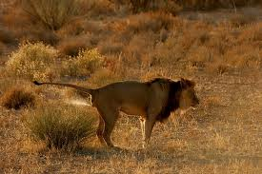

Slide 32
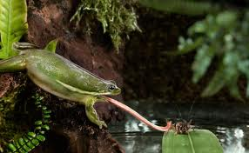

Slide 33
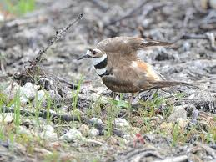

Slide 34
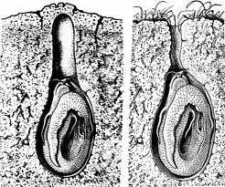

Slide 35
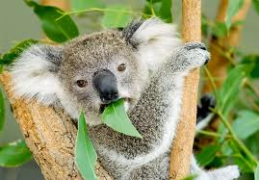
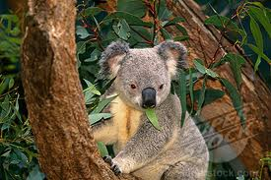

Slide 36
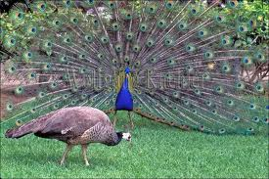

Slide 37
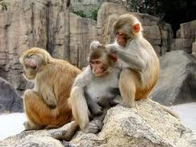

Slide 38
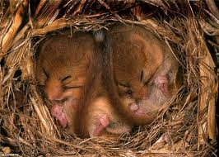

Slide 39
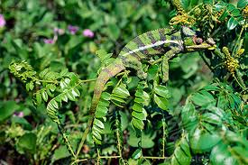
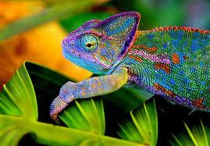

Slide 40
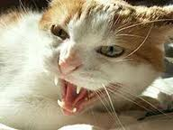

Slide 41
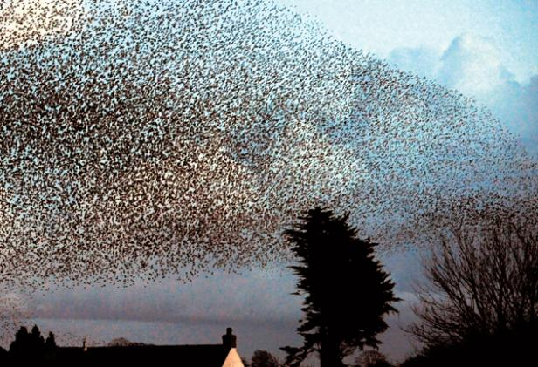

Slide 42
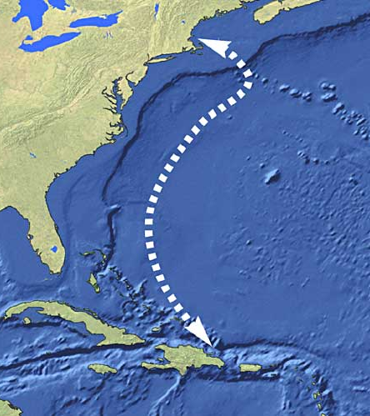
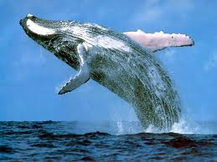

Slide 43
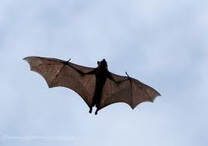

Slide 44
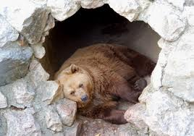

Slide 45
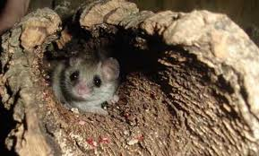

Slide 46
