Slide 1
Biodiversity Review Game
Mr. McKinney

Slide 10
What would be the effect of removing pine trees from this ecosystem?

Slide 11
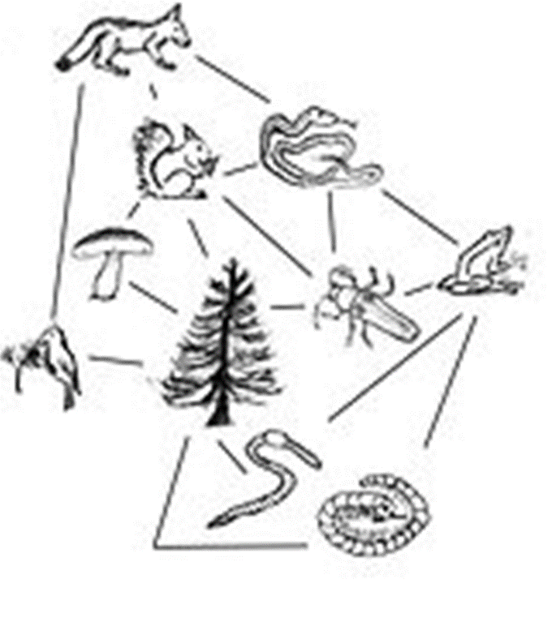
Beetles, squirrels, mushrooms, woodpeckers, and worms would struggle to survive. They eat or live on the trees.

Slide 12
What would happen if wolves disappeared from this ecosystem?

Slide 13
Snake, bird, and Squirrel populations would reproduce out of control. Possibly leading to a population crash.

Slide 14
What is the name for an organism that isn’t originally from an environment, but is introduced and reproduces successfully?

Slide 15
Invasive sPecies

Slide 16
What are two ways to decrease the biodiversity of an environment?

Slide 17
Deforestation, overfishing, poaching, etc.

Slide 18
Cane toads were introduced to Australia many years ago. In a short time cane toads had come to dominate the landscapes of Australia. What is the most likely explanation for cane toads’ success in the wild?

Slide 19
Cane toads have very few natural predators. (they’re actually poisonous!)

Slide 20
Which of these has the most biodiversity?
Soybean field
Lawn
Polluted lake
Northern forest

Slide 21
D

Slide 22
Biodiversity means?

Slide 23
“Different life”
Biodiversity is the total number of species living in an area.

Slide 24
Rainforests are some of the most diverse ecosystems on the planet. Which climate would you expect to have the greatest diversity of life in?
Cold and snowy
Hot and dry
Warm and moist
Cold and dry

Slide 25
C

