Slide 1
Chapter 4 Vocabulary
1.Adaptation = A characteristic that helps an organism survive and reproduce in its environment.
2.Species = A group of organisms that are closely related, and can mate with one another to produce fertile offspring.
3.Population = Groups of individuals of the same species, living in the same place.
4. Biodiversity – the variety of life in an ecosystem or habitat.

Slide 2
Adaptations
We covered adaptations in the last chapter.
Adaptations are characteristics that help an organism survive in its environment.
Some adaptations are physical. Give me some examples.
Some adaptations are behavioral. Give me some examples.

Slide 3
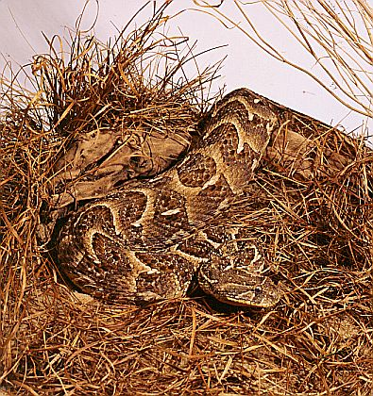
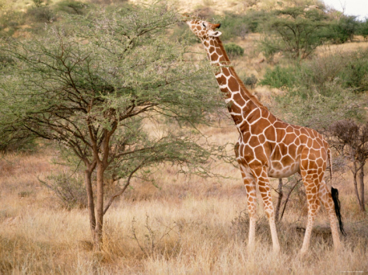
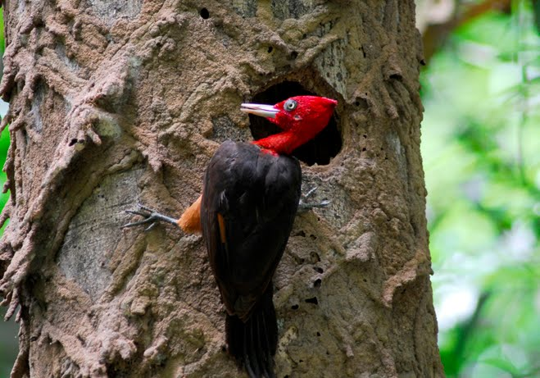
Physical adaptations
Striped coloring for Long neck to reach Long beak to get camouflage. leaves on a tree. termites out of a tree.

Slide 4
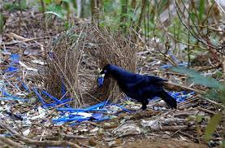
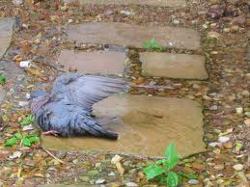
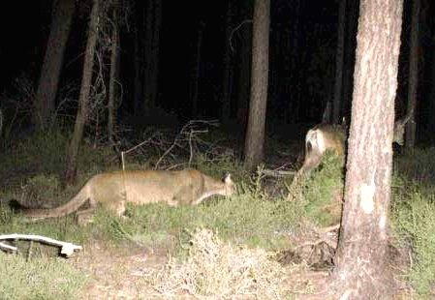
Behavioral adaptations
Bower bird building Bird pretending to be hurt Cougar stalking nest for mate to protect her young prey

Slide 5
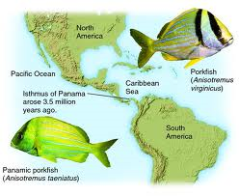
speciation
Speciation = The formation of a new species as a result of changes over time.
Separation
Adaptation
Division
A group in a species becomes separated form the original group (isolation). The group forms a new population.
Over time they adapt to their new environment.
Eventually, the new population and original population differ so greatly, they can no longer mate successfully. They are now a new species.

Slide 6
Adaptation to hunting (EX. Elephants)
Male elephants have tusks, but occasionally males are born with no tusks.
Hunters kill the elephants with tusks, so the elephants born with no tusks are left to reproduce.
Their offspring will not have tusks.

Slide 7
Adaptation to hunting

Slide 8
Adaptation to hunting

Slide 9
Insecticide resistance (EX. Crops)
Many crops must be sprayed with insecticide to kill the bugs, and protect the crops.
Occasionally, a bug is born resistant, so it will not be killed, and survives to reproduce.
Its offspring will also be insecticide resistant.

Slide 10
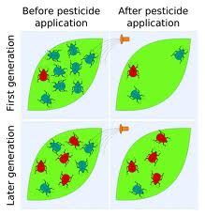
Insecticide resistance

Slide 11
Competition for mates (EX. Birds)
Survival of individuals does not guarantee survival of the species. An individual can survive but not reproduce.
Female birds prefer colorful males, so the colorful males will reproduce.
Their offspring will also be colorful.

Slide 12
Competition for mates

Slide 13
DISCUSS wHY DIVERSITY OF LIFE IMPORTANT?
DISCUSS How are humans causing THE DIVERSITY OF LIFE ON EARTH TO CHANGE?
WHAT CAN WE DO TO HELP or HURT?
Bio –life
Diversity- different

Slide 14
So why are ALL THESE SPECIES important?
More biodiversity is better for us all!
Because……………

Slide 15
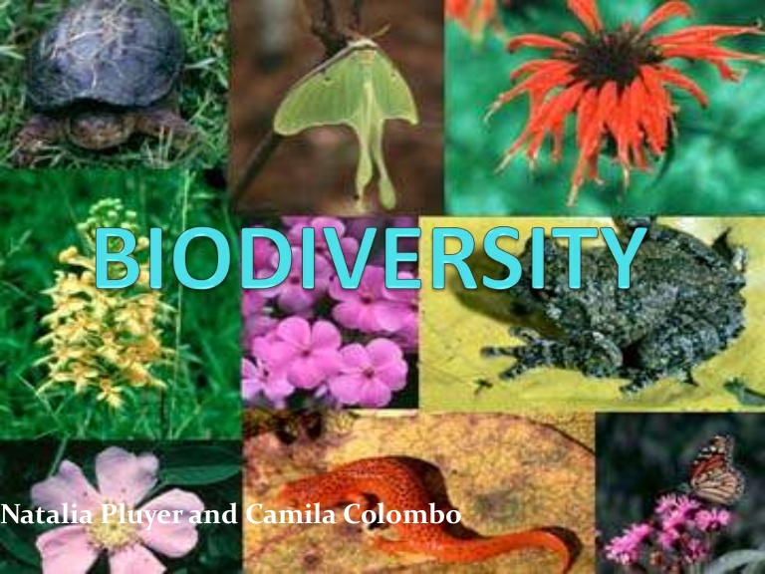
Benefits of Biodiversity
Ecosystem services
Cleaning water
Cleaning air
Habitat & breeding areas for wildlife
Aesthetic (beauty and cultural benefits)
Food
Resources
Medicines
Jobs, Tourism)

Slide 16
Natural Resources
Vital economic natural resources
Renewable
Forests (plants, wildlife)
Soils
Fresh water (lakes, rivers)
Wildlife and fisheries
Rangeland pastures
Nonrenewable
Minerals
Fossil Fuels

Slide 17
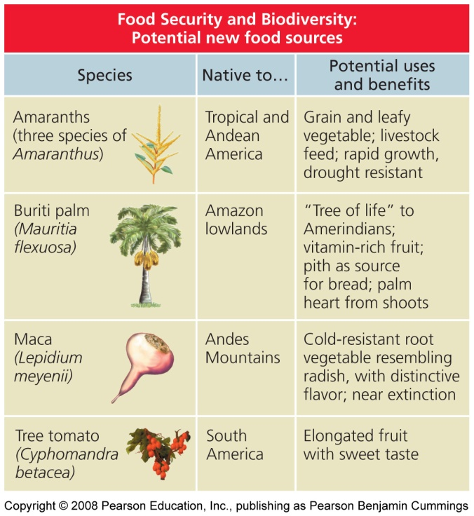
Benefits of Biodiversity
New food sources
Grains, fruits, vegetables, meat, fish

Slide 18
Benefits of Biodiversity
Medicines from, plants.
Also jellyfish
& sea anemones.

Slide 19
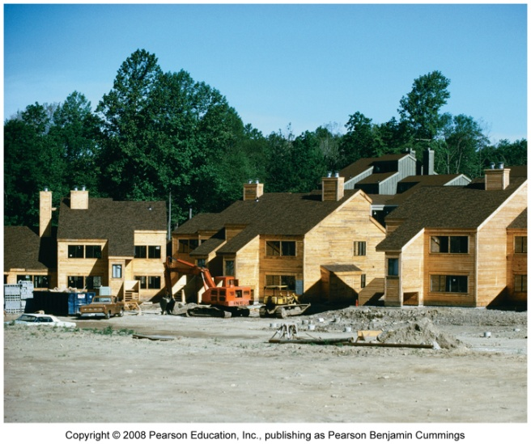
Threats to Biodiversity
Extinction and Population Reductions
Hunting and overharvesting
Tiger
Dodo bird
Whales
Sharks
Habitat loss, deforestation, urban development

Slide 20
Threats to Biodiversity
Extinction and Population Reductions
Pollution (air, water, soil)
Climate change (global warming)
Invasive species

Slide 21
Protecting Biodiversity
How can WE Protect Biodiversity?
Stop overharvesting
Hunting & fishing laws
in developing nations?
Protect habitat
Refuges, parks, preserves
Endangered Species Act of 1973
Reduce, Reuse, Recycle
Educate
Control chemical runoff

