Slide 1
Insecticide Resistance

Slide 2
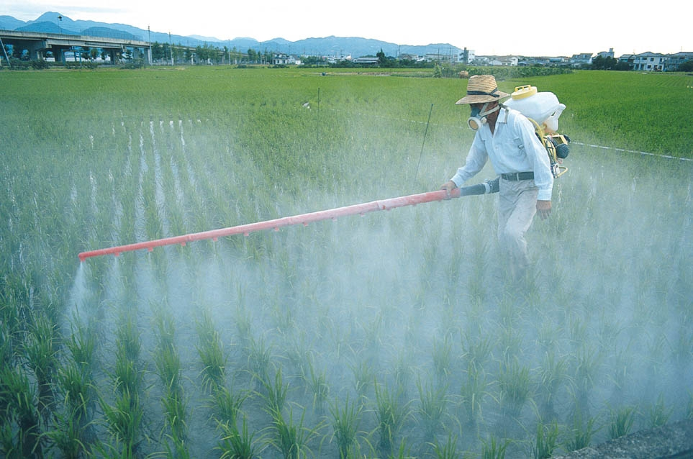
Food for thought…
Pesticides are chemicals that kill insects.
Farmers often notice that after years of using the same pesticide, they see a reduction in the effectiveness of their pesticides.
Why does this happen? Let’s think about it. We’ll come back to this.

Slide 3
Population Growth Always Involves:
Genetic Variation
Overproduction
Struggle to Survive
Successful Reproduction

Slide 4
Genetic Variation:
Genetic Variation is the genetic differences between different members of a species.
Found in sexual species.

Slide 5
Genetic Variation
Genetic variation can often be seen in physical appearance, but it is present in other parts of a creature’s physiology as well.
Immunities
Resistances
Weaknesses
These are all differences between organisms in a species.

Slide 6
Overproduction
When populations are in stable (safe) environments they overproduce.

Slide 7
Overproduction
When populations are in stable (safe) environments they overproduce.

Slide 8
Overproduction
When populations are in stable (safe) environments they overproduce.

Slide 9
Overproduction
When populations are in stable (safe) environments they overproduce.

Slide 10
Overproduction
When populations are in stable (safe) environments they overproduce.

Slide 11
Overproduction
Before long, there are too many organisms for the environment to support.

Slide 12
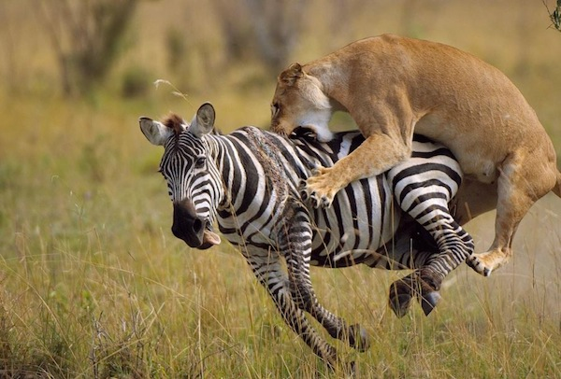
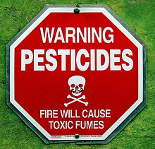
This overproduction creates a competition for survival.
The competition for survival can come from several sources:
Scarce resources
Predation
Chemicals/Poisons
Other harmful conditions.

Slide 13
Struggle to survive
In this struggle to survive, some animals will die off.
Often, other animals live because of their different ADAPTATIONS.
Immunities
Resistances
Etc.

Slide 14
Pesticides
Think back to our beetles. If these beetles eat a farmer’s crops, and he sprays pesticide on them, what is the driving force behind their struggle to survive?

Slide 15
Over time, what will we see?
As the pesticide kills beetles without an immunity to it, some beetles will live on to reproduce.

Slide 16
Over time, what will we see?
As the pesticide kills beetles without an immunity to it, some beetles will live on to reproduce.

Slide 17
Over time, what will we see?
Which beetles did not have an immunity? Which did?

Slide 18
Over time, what will we see?
What do you think we will see happen next?

Slide 19
Successful Reproduction
Since the green shelled beetles had an immunity to the poison (and survived), they will successfully reproduce.

Slide 20
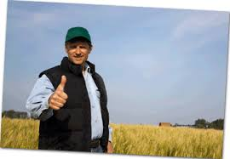
Now imagine that you are a farmer:
Your family has used the same pesticide for five years. The first year you used it you had flourishing crops. No bugs to be seen.
YOU

Slide 21
As the years go on, you notice more bugs coming back. So you spray more and more pesticide. This works for a while, too.

Slide 22
What would you do? Why is this happening?

Slide 23
Talk with a partner for a minute, then we will share.

Slide 24
Acquired Resistance to Pesticides
What your family didn’t realize was that they were creating an evolutionary pressure.
This pressure made it advantageous (helpful) for beetles to be immune to your pesticide.
Over time, there were no (or very few) beetles still vulnerable to your pesticide.
Your only solution would be to change the pesticide you are using to something they are not immune to.
This phenomenon is called pesticide resistance.

